Slide 1

NEXUS BANK
CASE STUDY

Slide 2
AGENDA
Define Clear Objectives
Data Gathering and Preparation
Perform Exploratory Data Analysis
Model Development and Evaluation
Generate Insights and Recommendations

Slide 3
CLEAR OBJECTIVES OF THIS PROJECT
Utilize data analysis techniques, including demographic factors such as age, to effectively address risks, minimize loan defaults, and enhance operational efficiency at Nexus Bank.
Identify customers who are more likely to make a deposit through accurate prediction, enabling the optimization of marketing and targeting strategies.
Allocate marketing resources more efficiently, personalize campaigns, and improve customer satisfaction by leveraging data-driven insights and recommendations.
Optimize marketing campaigns, target specific customer segments, and enhance customer deposits at Nexus Bank based on data-driven analysis.
Enhance the overall performance and profitability of Nexus Bank by leveraging data mining techniques, implementing predictive models, and driving data-informed decision-making processes.

Slide 4
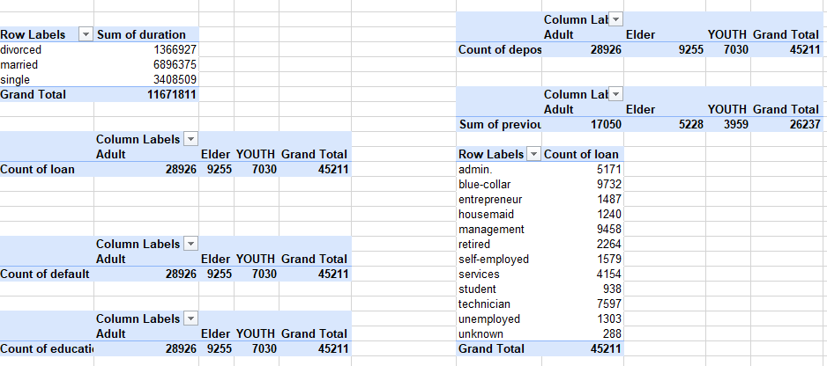
DATA GATHERING AND PREPARATION
After gathering , cleaning and preparing data, it was grouped into BINS Using this formular (=IF([@age]<=30, "YOUTH", IF([@age]<=50, "Adults", "Elder"))
This formula categorizes individuals based on their age into three groups: "YOUTH" for ages less than or equal to 30, "Adults" for ages between 31 and 50, and "Elder" for ages 51 and above.
Based on the information provided in the tables, it can be concluded that adults have a higher count of loans and defaults compared to the other age groups, despite potentially having a higher level of education.
Another observation on the provided data shows that the top three professions that accessed the most loans are:
Blue-collar: 9,732 loans
Management: 9,458 loans
Technician: 7,597 loans
Additionally, the "Married" group accessed more loans, with a total loan duration of 6,896,375. possibly due to their increased stability and combined financial resources..

Slide 5
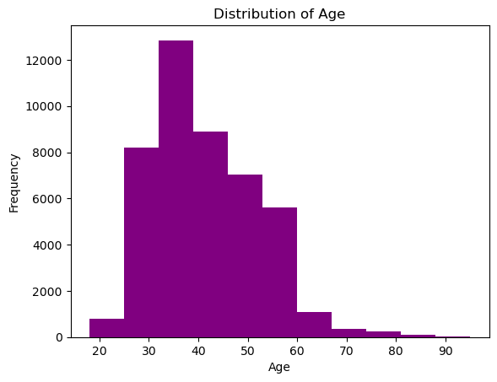
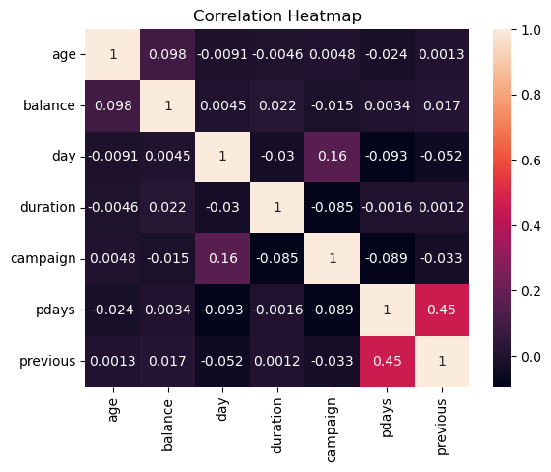
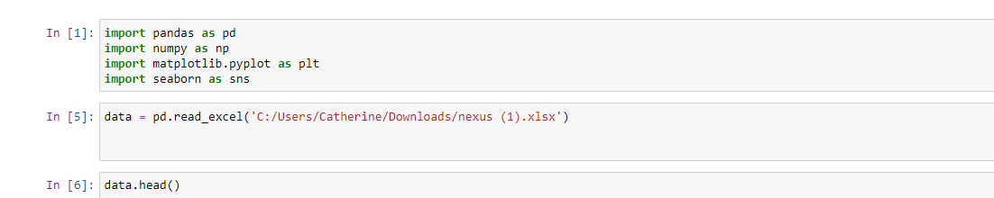
Perform Exploratory Data Analysis
the overall distribution of ages
Heatmap visualizing the correlations between variables

Slide 6
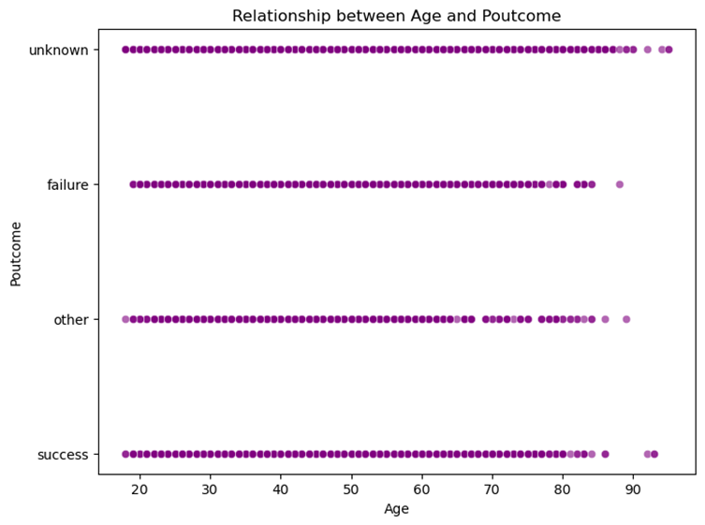
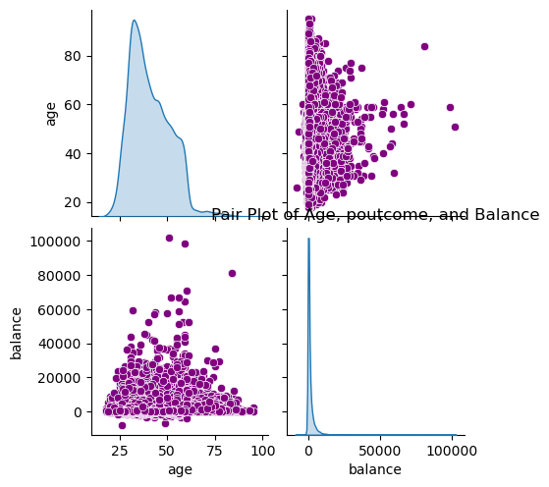
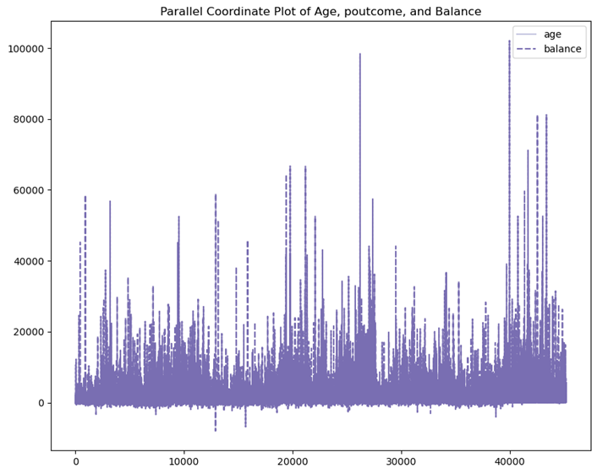
Exploratory Data Analysis - Relationships and Visualization
Relationship between Age and income
Parallel Coordinate Plot of Age, income, and Balance
Pair Plot of Age, income and Balance

Slide 7
Model Development and Evaluation
We evaluated two supervised learning models: Logistic Regression and Random Forest. These models were trained on historical customer data and tested for their ability to accurately predict potential depositors.
Logistic Regression:
Accuracy: 88.93%
This model achieved an accuracy rate of 88.93%, indicating that it correctly predicted the deposit status of customers in 88.93% of cases. It provides a reliable baseline for predicting potential depositors.
Random Forest:
Accuracy: 90.57%
The Random Forest model outperformed the Logistic Regression model with an accuracy rate of 90.57%.
Its higher accuracy suggests that it can provide more precise predictions for identifying potential depositors.

Slide 8
INSIGHTS AND RECOMMENDATIONS
Insights:
Age Group Analysis: Adults have the highest count of deposits compared to Elders and Youth. This suggests that targeting marketing campaigns towards the adult segment may yield better results in terms of acquiring deposits.
Marital Status Impact: Married individuals have a significantly higher sum of duration compared to divorced and single individuals. This indicates that married individuals may be more likely to maintain longer-term banking relationships. Tailoring products and services to cater to the needs of married customers can help in fostering enduring relationships.
Loan and Default Analysis: The blue-collar profession has the highest count of loans, followed by management and technician professions. It's important to assess the risk associated with these professions and implement appropriate risk mitigation strategies to minimize default probabilities.
Recommendations:
Targeted Marketing: Develop targeted marketing campaigns that specifically cater to the adult segment, as they have shown a higher inclination towards depositing. Customize messaging and offers to resonate with their needs and goals.
Relationship Building: Focus on building strong relationships with married individuals by offering personalized financial solutions that align with their joint financial objectives. This can include bundled services, joint accounts, and preferential interest rates for long-term customers.
Risk Management: Pay close attention to the loan portfolios of customers in blue-collar, management, and technician professions. Conduct thorough risk assessments to identify potential defaulters and implement proactive measures to mitigate risks.
Customer Engagement: Continuously engage with customers through personalized interactions, educational content, and financial planning tools. This can help in deepening customer relationships and increasing loyalty.
By implementing these recommendations, you can enhance customer engagement, optimize marketing efforts, manage risks effectively, and foster long-term relationships with customers, ultimately leading to improved business performance for Nexus Bank.

